Slide 1
CPR E 281: Digital Logic
Md Maruf Ahamed
Office: 307 Durham Center
Phone: (515) 294-6323
Email: maruf@iastate.edu

Slide 2
Administrative Stuff
  Homework: HW #02 due on Sunday @ 11:59 PM
  Quiz: Quiz #3 due on Friday @ 4:25 PM
  Recitation: Recitation #03 next week
  Lab: Lab # 03 next week
      Submit pre-lab prior to the lab otherwise you will lose 20% points
  Lecture-9 Readings: Section 2.11

Slide 3
08 – Intro to Verilog HDL
  7-Segment Display
  A Typical CAD system
  Hardware Description Languages
  Intro to Verilog HDL
  Representation of Digital Circuits in Verilog
  Structural Representation
  Behavioral Representation

Slide 4
Review

Slide 5
Introduction to CAD Tools
Redings-2.9, 2.10
References:
Stephen Brown and Zvonko Vranesic , Fundamentals of Digital Logic with Verilog Design 3rd edition.
Z. Navabi, Verilog Digital System Design, 2nd ed., (McGraw-Hill: New York, 2006).
D. A. Thomas and P. R. Moorby, The Verilog Hardware Description Language, 5th ed., (Kluwer: Norwell, MA, 2002).
Tutorial: http://www.asic-world.com/verilog/

Slide 6
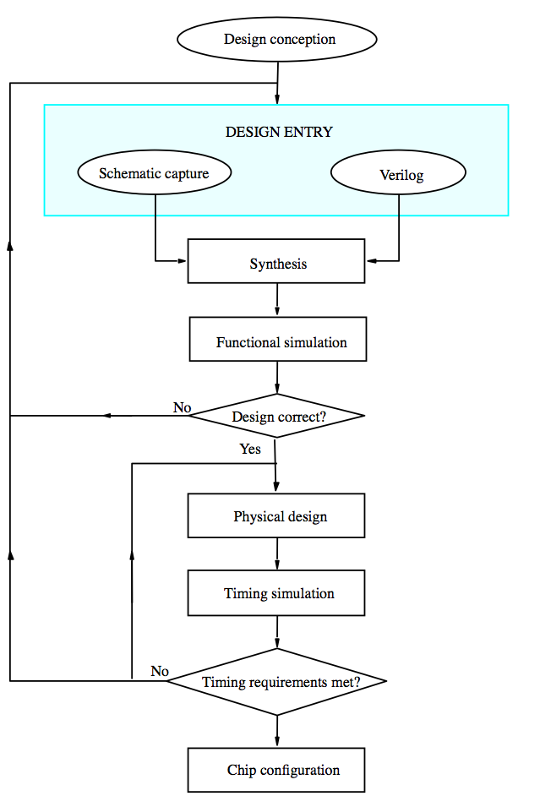
A typical CAD system
Figure 2.35 A typical CAD system. [1]

Slide 7
Computer-Aided Design (CAD) tools
Based on Hardware Description Language (HDL).
HDLs provide formats for representing the outputs of various design steps.
A CAD tool transforms its HDL input into a HDL output that contains more detailed information about the hardware.
    Behavioral level to register transfer level
    Register transfer level to gate level
    Gate level to transistor level
    Transistor level to the layout level

Slide 8
Need of Computer-Aided Digital Designing
Design process becomes complicated and complex
Computer-aided techniques became critical for the design, and verification
CAD tools do automatic placement and routing of the circuit layouts
Design time reduced
Less human brain utilization
Chances of human error is reduced

Slide 9
HDLs
Hardware Description Languages
  Widely used in logic design
  Verilog HDL and VHDL
Describe hardware using code
  Document logic functions
  Simulate logic before building
  Synthesize code into gates and layout
    Requires a library of standard cells

Slide 10
Two Competing HDLs
Hardware Description Language (HDL)
  Verilog HDL
  VHDL (Very High Speed Integrated Circuit HDL)
  Designs are created typically using HDLs, which get transformed from one level of abstraction to the next as the design flow progresses.

Slide 11
Verilog HDL != VHDL
These are two different Languages!
Verilog is closer to C
VHDL is closer to Ada

Slide 12
History
Created in 1983/1984
Verilog-95 (IEEE standard 1364-1995)
Verilog 2001 (IEEE Standard 1364-2001)
Verilog 2005 (IEEE Standard 1364-2005)
SystemVerilog
SystemVerilog 2009 (IEEE Standard 1800-2009).

Slide 13
Intro to Verilog
To describe a digital system as a set of Modules.
  Each of the modules will have an interface to other modules, in addition to it’s description.
  Two ways to specify a module:
        By specifying its internal logical structure (i.e., Structural Representation)
        By describing its behavior in a program-like manner (i.e., Behavioral Representation)
  The modules are interconnected using nets, which allow them to work each other.

Slide 14
Intro to Verilog
Module 1
module moduleName (I/O ports);
  define input ports;
  define output ports;
  // Parallel statements;
endmodule
Module 2
Module 3
. . . . . .
Module N

Slide 15
Concept of Verilog Module
module moduleName (I/O ports);
  define input ports;
  define output ports;
  // Parallel statements;
endmodule

Slide 16
Concept of Verilog Module
In Verilog, the basic unit of hardware is called a module.
A module cannot contain definition of other modules
A module can, however, be instantiated within another module
Instantiation allows the creation of a hierarchy in Verilog description
The names of modules and signals in Verilog code follow two simple rules:
the name must start with a letter, and it can contain any letter or number plus the “_” underscore and “$” characters.
Verilog is case sensitive. Thus, the name k is not the same as K and Example1 is not the same as example1.
White space characters, such as SPACE and TAB, and blank lines are ignored.
Multiple statements can appear on a single line.
module module_name (list_of_ports);
input/output declarations
local net declarations
parallel statements
endmodule

Slide 17
“Hello World” in Verilog
[http://en.wikipedia.org/wiki/Verilog]

Slide 18
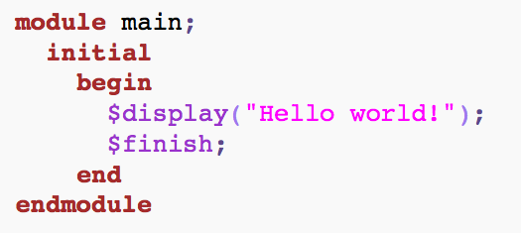
“Hello World” in Verilog
[http://en.wikipedia.org/wiki/Verilog]

Slide 19

Verilog Code: Structural Representation
Specifies how components are interconnected.
In general, the description is a list of modules and their interconnection.
  Called netlist.
  Can be specified at various levels.

Slide 20
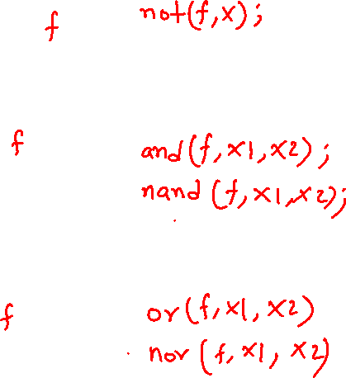
How to specify a logic gates in Verilog?
Verilog code
x
x
NOT gate
x
1
x
.
x
x
1
2
2
AND gate
x
1
x
+
x
x
1
2
2
OR gate

Slide 21
How to specify a logic gates in Verilog?
Verilog code
x
x
not (f, x)
NOT gate
x
1
x
.
x
and (f, x1, x2)
x
1
2
2
AND gate
x
or (f, x1, x2)
1
x
+
x
x
1
2
2
OR gate

Slide 22
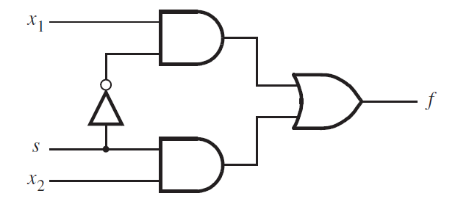
2-1 Multiplexer
s
x
0
1
f
x
1
2
f (s, x_{1,} x₂) =
s x₁
+
s x₂
[ Figure 2.36 from the textbook ]

Slide 23
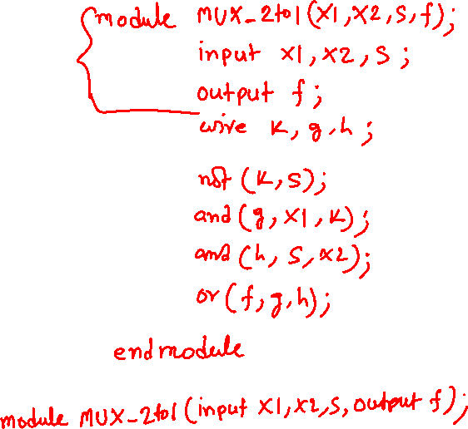
Verilog Code for a 2-1 Multiplexer
g
k
h
f (s, x_{1,} x₂) =
s x₁
+
s x₂
[ Figure 2.36 from the textbook ]
[ Figure 2.37 from the textbook ]

Slide 24
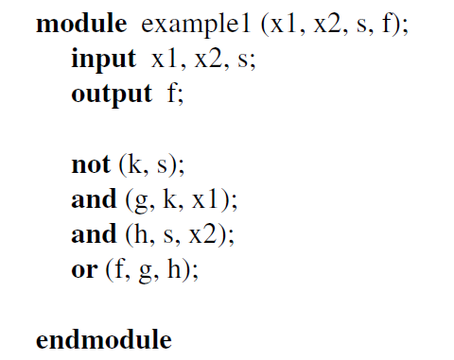
Verilog Code for a 2-1 Multiplexer
g
k
h
wire k, g, h;
f (s, x_{1,} x₂) =
s x₁
+
s x₂
[ Figure 2.36 from the textbook ]
[ Figure 2.37 from the textbook ]

Slide 25
Verilog Code: Behavioral Representation
Specifies how a particular design should respond to a given set of inputs.
May be specified by:
  Boolean equations
  Tables of input and output values
  Algorithms written in standard HLL like C
  Algorithms written in special HDL like Verilog or VHDL

Slide 26
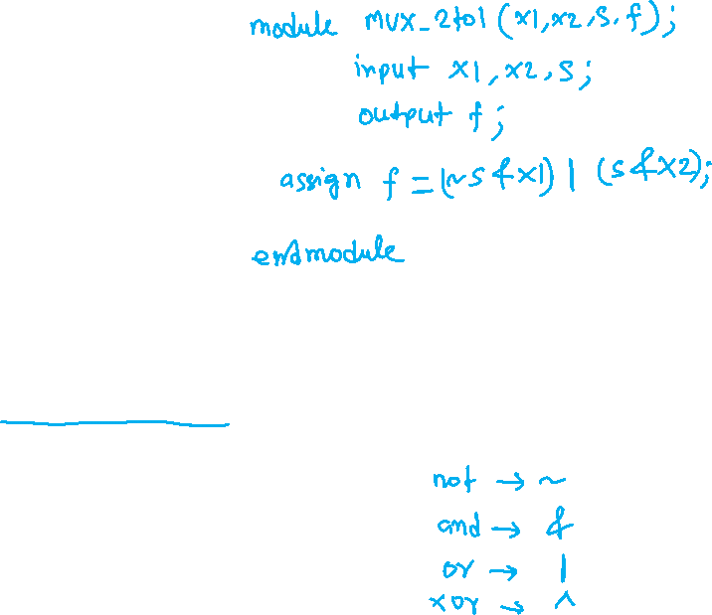
Verilog Code for a 2-1 Multiplexer
g
k
h
f (s, x_{1,} x₂) =
s x₁
+
s x₂
[ Figure 2.36 from the textbook ]
[ Figure 2.40 from the textbook ]

Slide 27
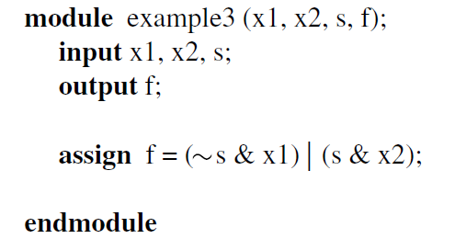
Verilog Code for a 2-1 Multiplexer
g
k
h
f (s, x_{1,} x₂) =
s x₁
+
s x₂
[ Figure 2.36 from the textbook ]
[ Figure 2.40 from the textbook ]

Slide 28

Data Types in Verilog
A variable in Verilog belongs to one of two data types:
Net
  Must be continuously driven
  Cannot be used to store a value
  Used to model connections between continuous assignments and instantiations.
Register
  Retains the last value assigned to it.
  Often used to represent storage elements, but sometimes it can translate to combinational circuits also.

Slide 29
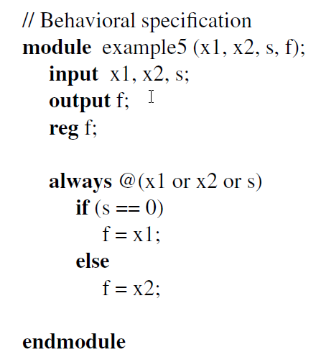
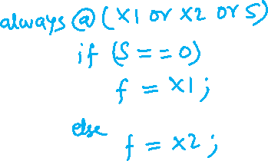
Verilog Code for a 2-1 Multiplexer
g
k
h
[ Figure 2.36 from the textbook ]
[ Figure 2.42 from the textbook ]

Slide 30
Verilog Code for a 2-1 Multiplexer
g
k
h
[ Figure 2.36 from the textbook ]
[ Figure 2.42 from the textbook ]

Slide 31
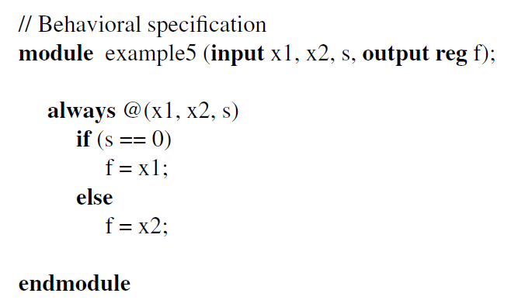
Verilog Code for a 2-1 Multiplexer
g
k
h
[ Figure 2.36 from the textbook ]
[ Figure 2.43 from the textbook ]

Slide 32
Another Example

Slide 33
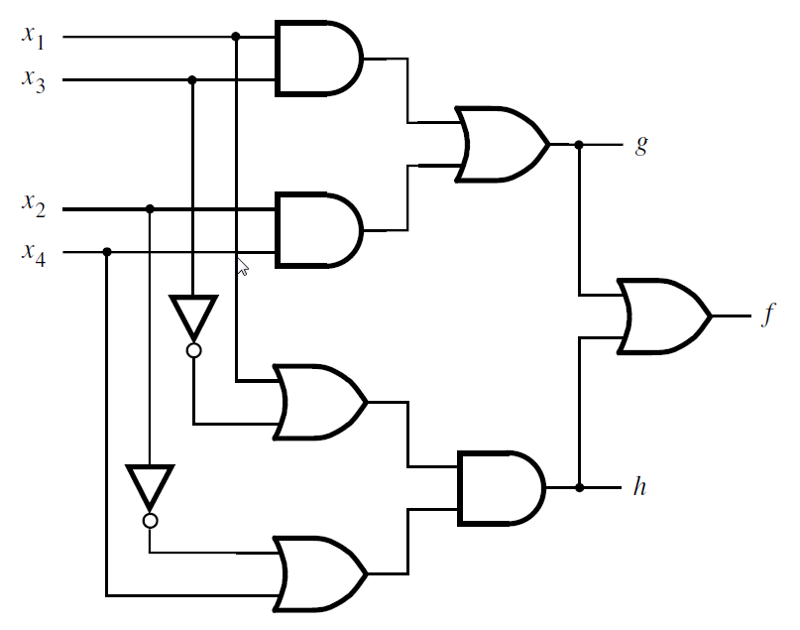
Let’s Write the Code for This Circuit
[ Figure 2.39 from the textbook ]

Slide 34
Let’s Write the Code for This Circuit
module example2 (x1, x2, x3, x4, f, g, h);
input x1, x2, x3, x4;
output f, g, h;
and (z1, x1, x3);
and (z2, x2, x4);
or (g, z1, z2);
or (z3, x1, ~x3);
or (z4, ~x2, x4);
and (h, z3, z4);
or (f, g, h);
endmodule
z1
wire z1, z2, z3, z4;
z2
z3
z4
[ Figure 2.39 from the textbook ]
[ Figure 2.38 from the textbook ]

Slide 35

Let’s Write the Code for This Circuit
module example4 (x1, x2, x3, x4, f, g, h);
input x1, x2, x3, x4;
output f, g, h;
assign g =
assign h =
assign f =
endmodule
[ Figure 2.39 from the textbook ]
[ Figure 2.41 from the textbook ]

Slide 36
Let’s Write the Code for This Circuit
module example4 (x1, x2, x3, x4, f, g, h);
input x1, x2, x3, x4;
output f, g, h;
assign g = (x1 & x3) | (x2 & x4);
assign h = (x1 | ~x3) & (~x2 | x4);
assign f = g | h;
endmodule
[ Figure 2.39 from the textbook ]
[ Figure 2.41 from the textbook ]

Slide 37
Yet Another Example

Slide 38
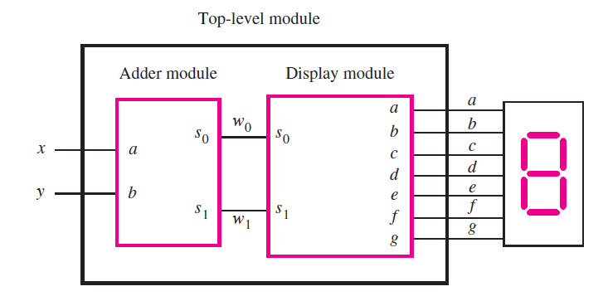

A logic circuit with two modules
[ Figure 2.44 from the textbook ]

Slide 39
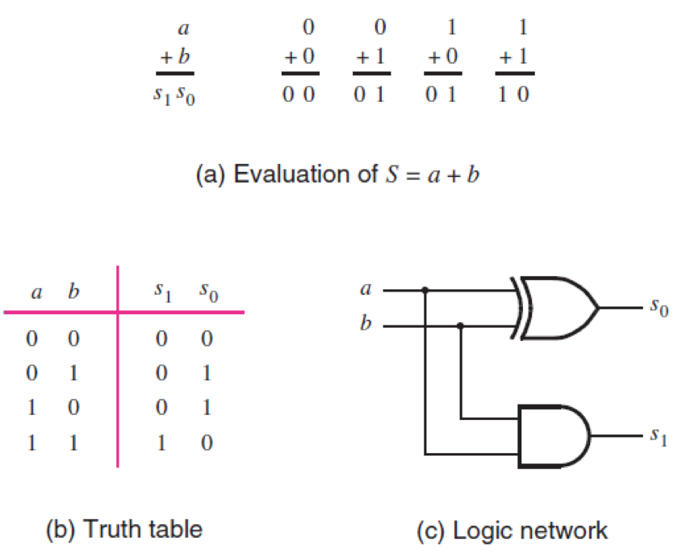
The adder module
[ Figure 2.12 from the textbook ]

Slide 40
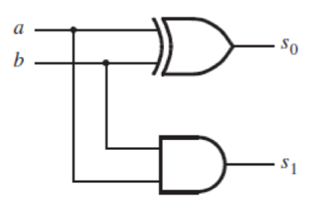
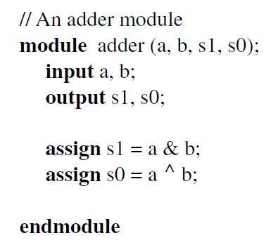
The adder module
[ Figure 2.45 from the textbook ]

Slide 41
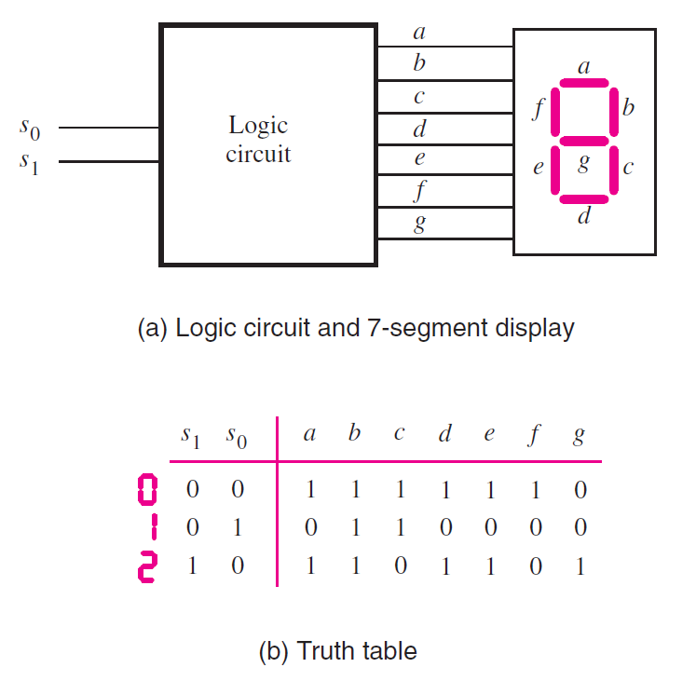
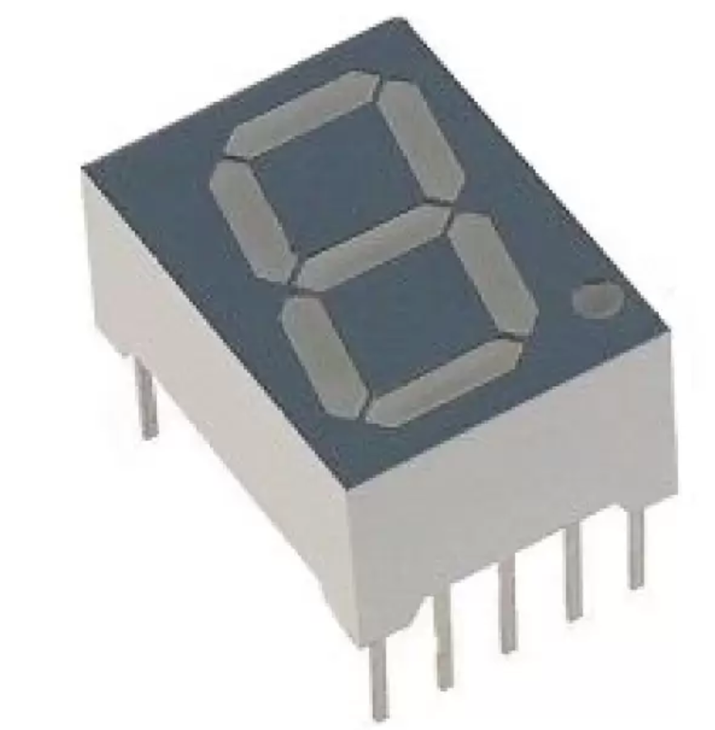

Display of numbers
a
b
S₁ S₀
[ Figure 2.34 from the textbook ]

Slide 42
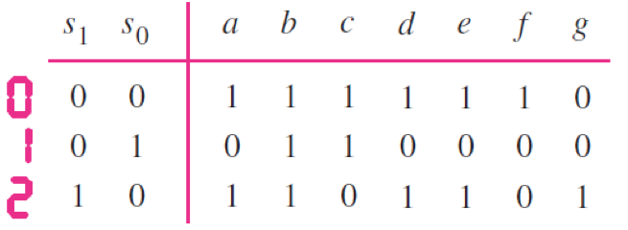
Display of numbers
a = s₀
c = s₁
e = s₀
g = s₁ s₀
d = s₀
f = s₁ s₀
b = 1

Slide 43
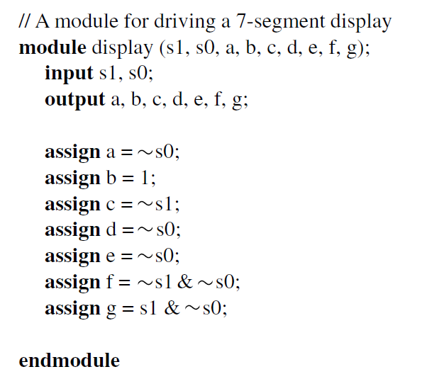
The display module
a = s₀
b = 1
c = s₁
d = s₀
e = s₀
f = s₁ s₀
g = s₁ s₀
[ Figure 2.46 from the textbook ]

Slide 44
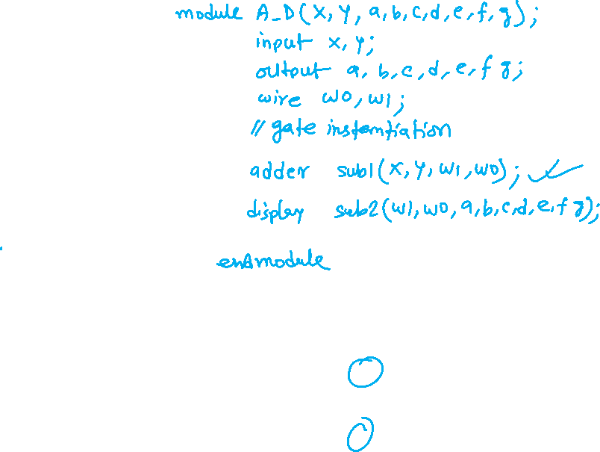
Putting it all together

Slide 45
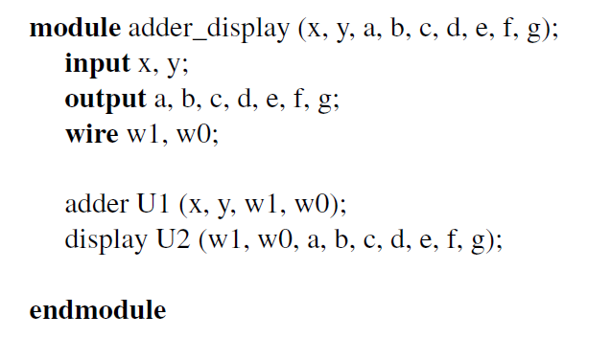
Putting it all together

Slide 46
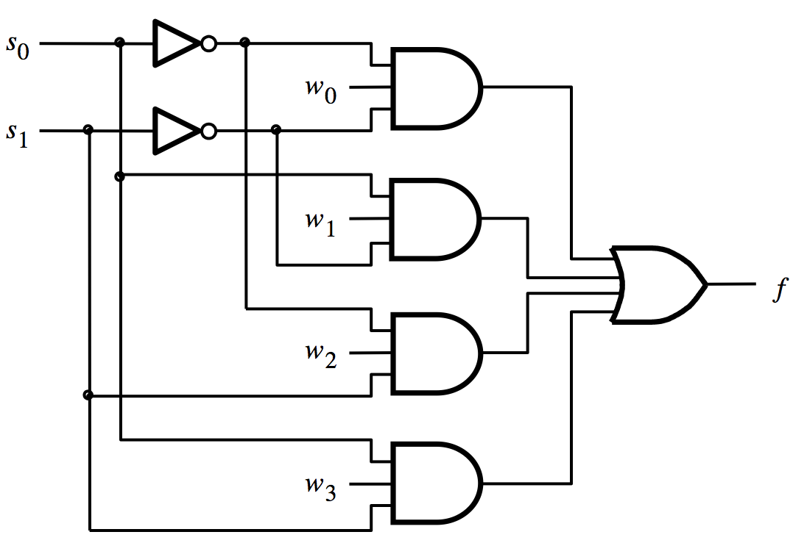
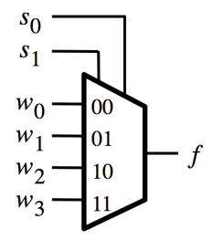
Verilog Code for 4-1 MUX

Slide 47




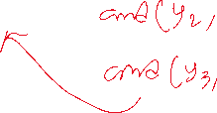







Verilog Code for 4-1 MUX

Slide 48

END Slide

